Slide 1
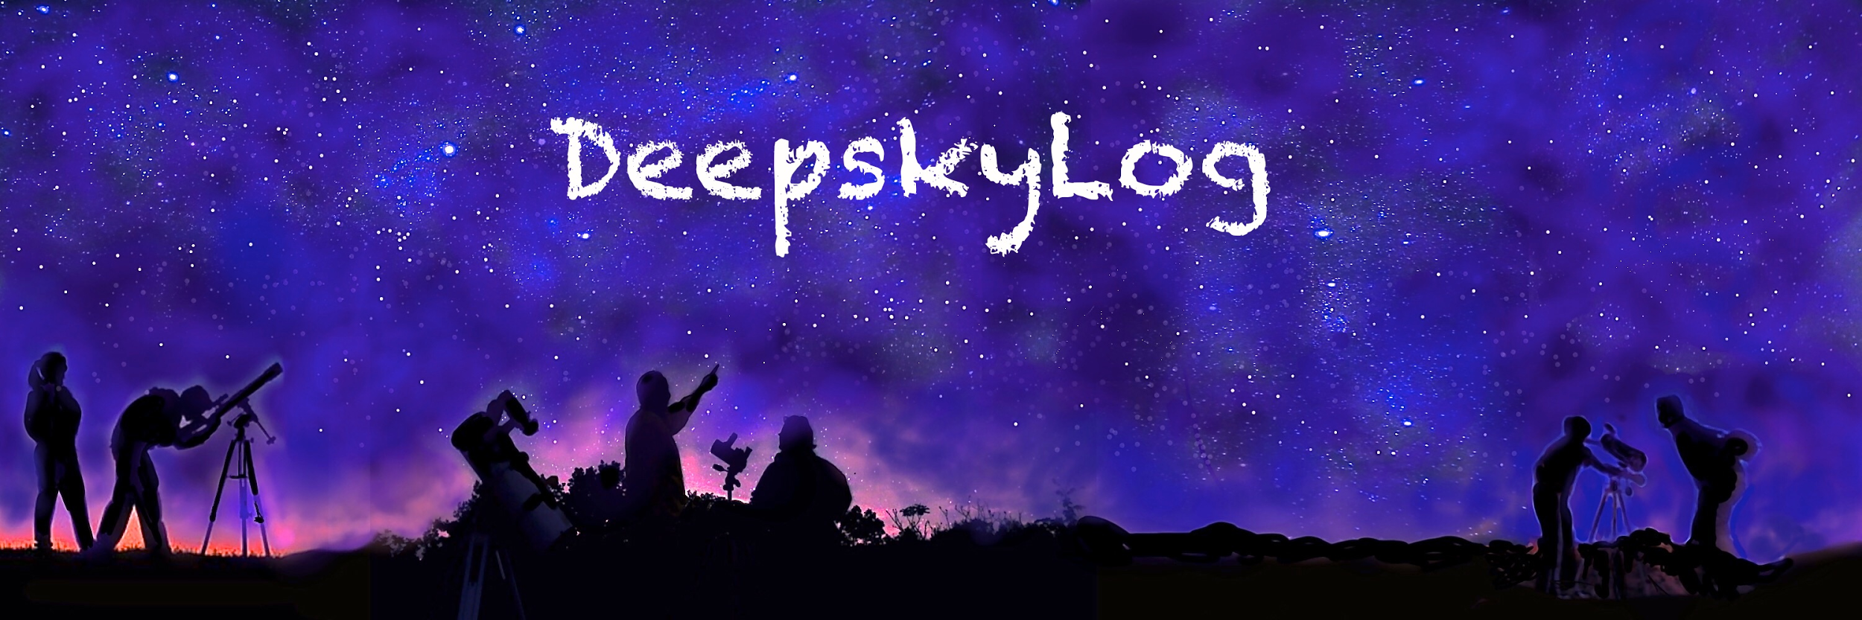
Vela
Telescope Control System in the 21st century

Slide 2
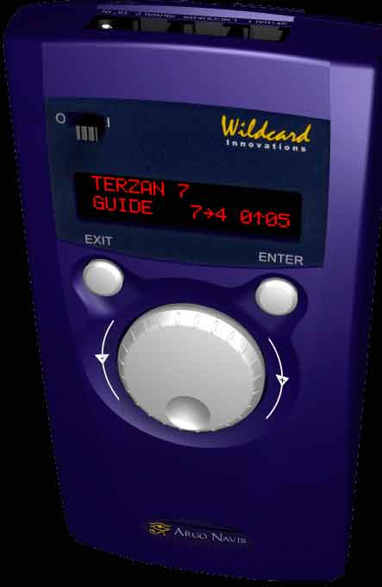

Slide 3
Drawbacks
Only settings circles
No internet connection to upload new objects, lists, comets, …
Limited memory
Expensive

Slide 4
Going further
Android smartphone / tablet (>= 4.3)
Arduino hardware + Bluetooth shield
Control
Mirror fan
Secundary mirror heating
Setting circles
Motors
Inexpensive
Vela Telescope Control System

Slide 5


Slide 6
Status
https://github.com/DeepskyLog/Vela
Connection with
DeepskyLog
Bluetooth on arduino

Slide 7
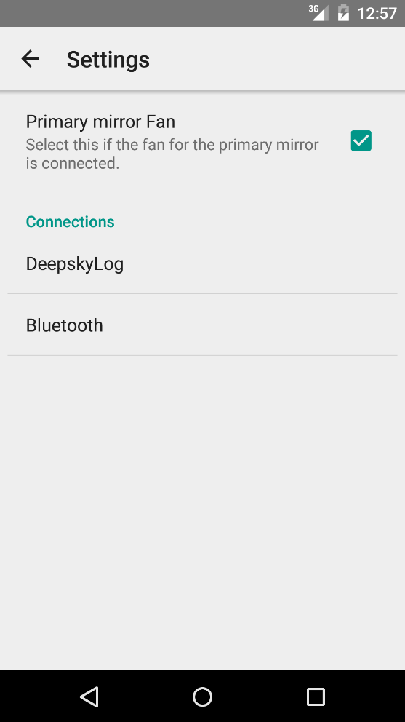

Slide 8
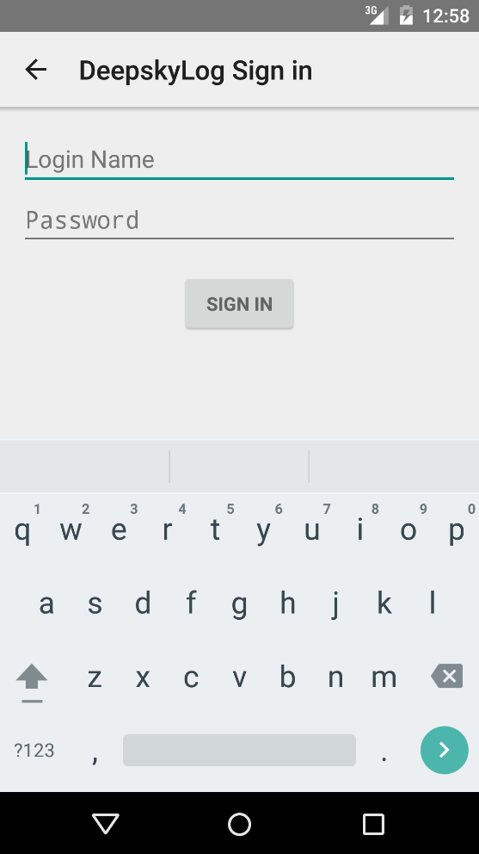

Slide 9
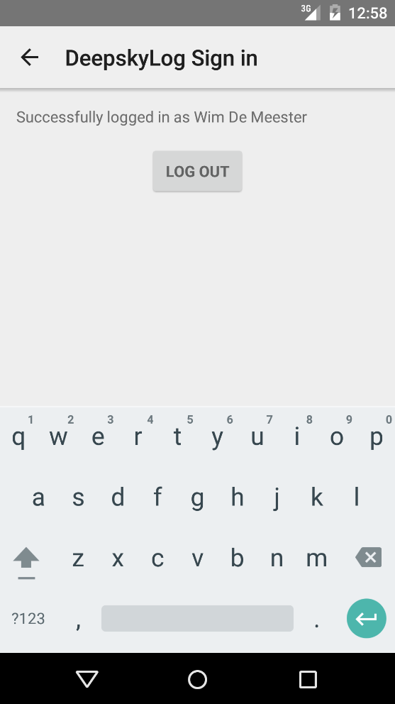

Slide 10
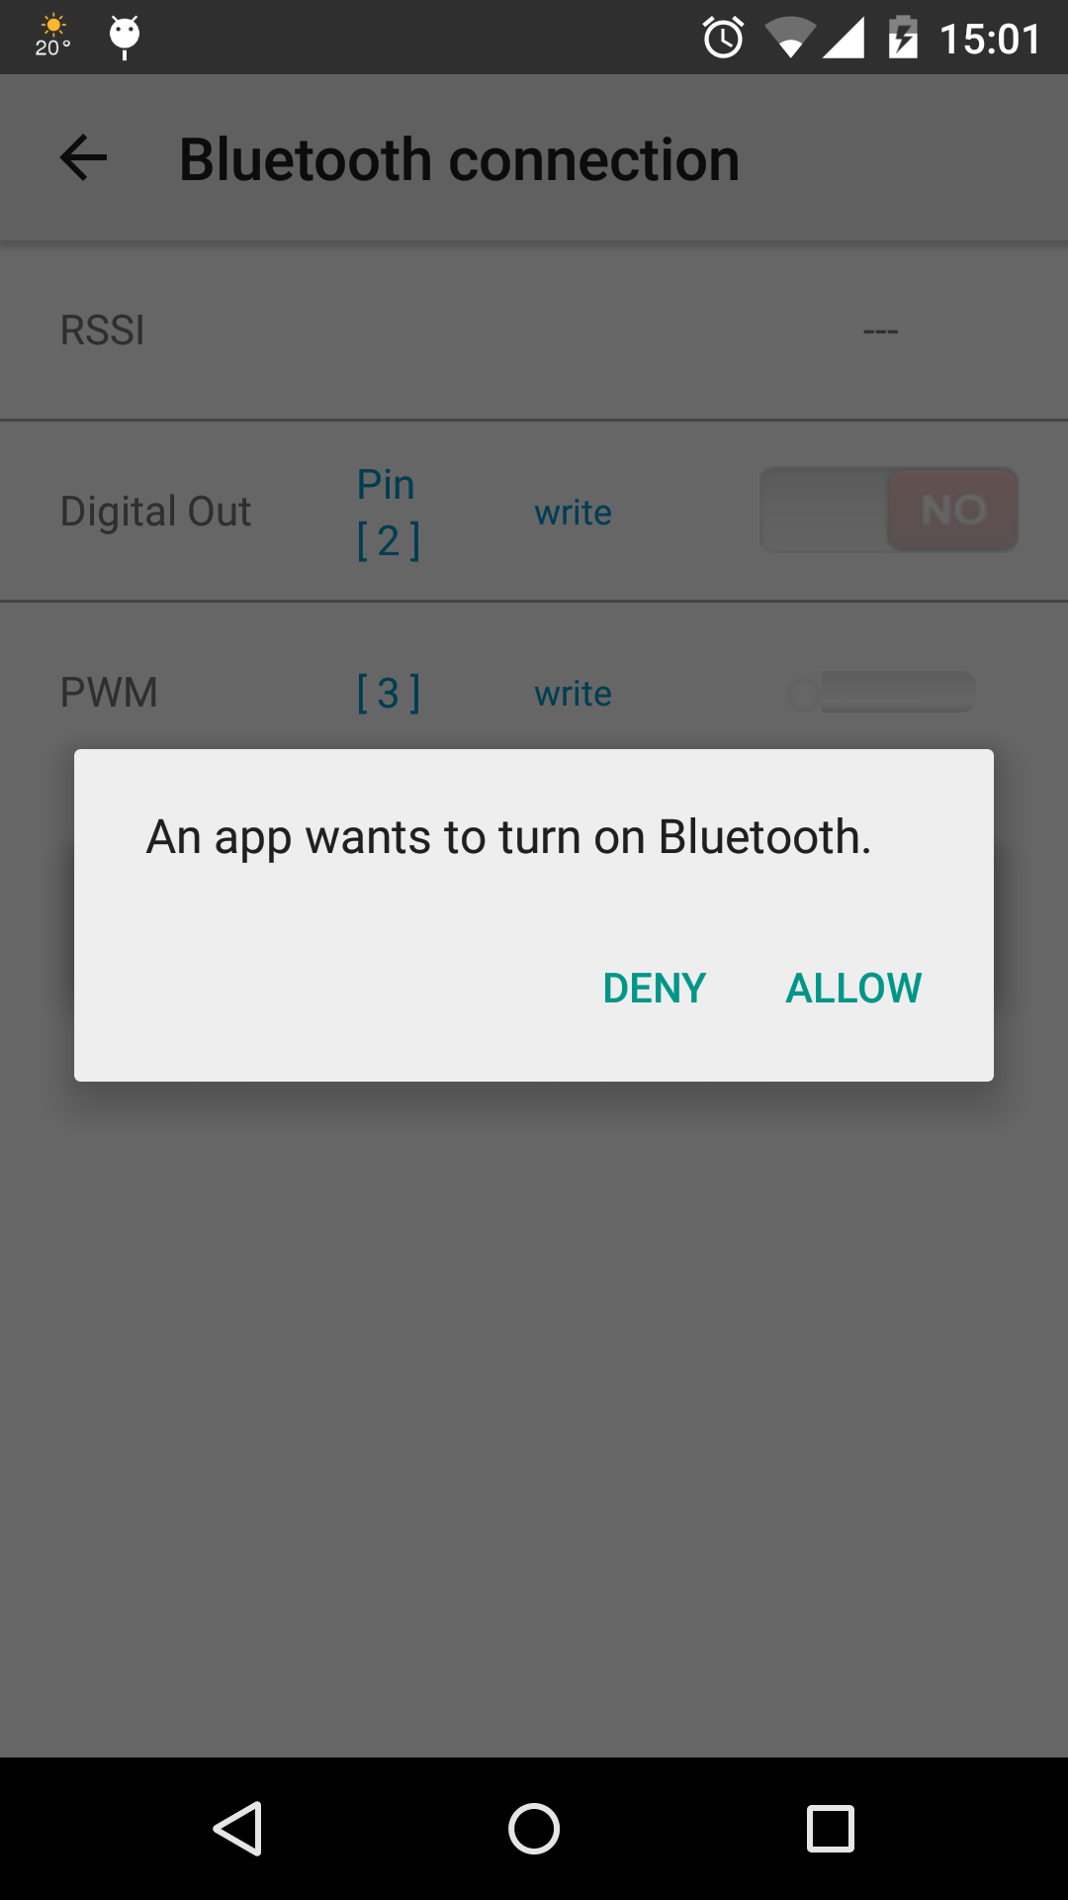

Slide 11
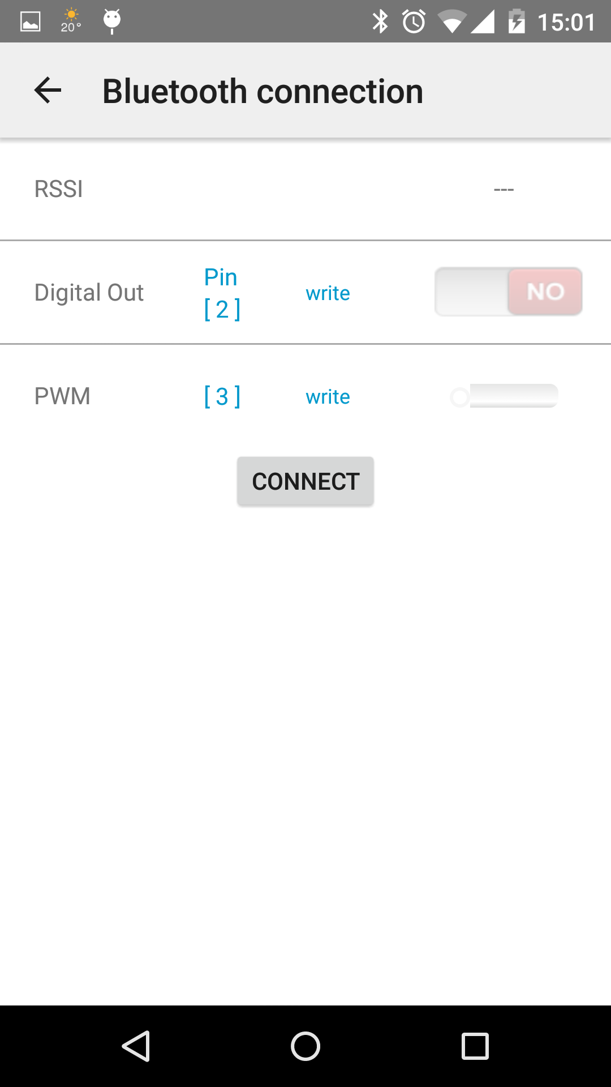

Slide 12
Next steps
Write Arduino sketch to control fan
Make hardware
Release V0.1

Slide 13
Next steps: hardware
Add temperature sensors
Air
Secondary mirror
Primary mirror
Add heating
Add Digital encoders
Add motors

Slide 14
Next steps: Software
Add night mode
DeepskyLog integration - offline
Use the objects
Use observing lists
Use list of locations to get weather and driving directions
Enter observations (Speech recognition?)
...

Slide 15
Next steps: Software
DeepskyLog integration - online
Show all drawing of the object to observe
Show starcharts
Show observations
…
Track comets / asteroids / satellites

